Slide 1
Users behavior analysis
Content view ratio for weekdays
Folder view ratio

Slide 2
Outline
Types of users on their view ratios on different weekdays
Types of users on their preference viewing folders in courses

Slide 3
PCA analysis
I use PCA technique in Machine Learning to decompose hundred of users into different groups with different preferences. Data is summarized until 09-21

Slide 4
Which weekday users usually log in and view contents?
Strategi STR3605 course
(Percent of content view students spend on app in weekdays)
For example, user type 1 accounts for 50% of current students, spends 94% time using app on Monday.
 | Variance explained | Mon | Tue | Wed | Thu | Fri | Sat | Sun
User type 1 | 50% | 0.94 | 0 | 0.06 | 0 | 0 | 0 | 0
User type 2 | 17% | 0.13 | 0 | 0.88 | 0 | 0 | 0 | 0
User type 3 | 15% | 0.12 | 0.71 | 0.18 | 0 | 0 | 0 | 0
User type 4 | 9% | 0.2 | 0 | 0 | 0.8 | 0 | 0 | 0

Slide 5
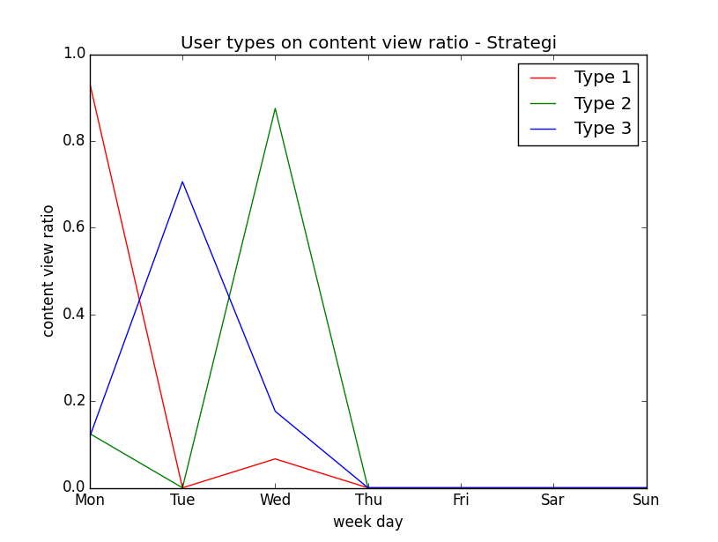
Which weekday users usually log in and view contents?
Strategi STR3605 course

Slide 6
Which weekday users usually log in and view contents?
Strategi STR3605 course
Most students only logged in on lecture-day and not coming back in days later.
90% students logged in Monday, Tuesday, or Wednesday. 25% of them only use app on 2 days after, instead of lecture day.
There is no activities of using app on weekend

Slide 7
Which weekday users usually log in and view contents?
Kulturledelse KLS3551
 | Variance explained | Mon | Tue | Wed | Thu | Fri | Sat | Sun
User type 1 | 37% | 0.75 | 0.06 | 0.06 | 0 | 0.06 | 0 | 0.06
User type 2 | 23% | 0.05 | 0.56 | 0.39 | 0 | 0 | 0 | 0
User type 3 | 13% | 0.3 | 0 | 0 | 0.7 | 0 | 0 | 0
User type 4 | 11% | 0 | 0.34 | 0 | 0 | 0 | 0 | 0.67
User type 5 | 9% | 0.17 | 0.28 | 0 | 0 | 0.34 | 0.12 | 0.12

Slide 8
Which weekday users usually log in and view contents?
Kulturledelse KLS3551
23% students spend 95% their app time on Tuesday and Wednesday ( 2 day after lecture day)
User type 4 and 5, account for 20% users, usually use app on weekend. This is different from users of Strategi. Maybe this indicates this course has more homeworks?

Slide 9
Which weekday users usually log in and view contents?
Entrepreneurship ELE3702
 | Variance explained | Mon | Tue | Wed | Thu | Fri | Sat | Sun
User type 1 | 44% | 0 | 0.28 | 0.71 | 0 | 0 | 0 | 0
User type 2 | 30% | 0.15 | 0.69 | 0 | 0.15 | 0 | 0 | 0
User type 3 | 17% | 0.88 | 0 | 0.11 | 0 | 0 | 0 | 0
User type 4 | 11% | 0 | 0.34 | 0 | 0 | 0 | 0 | 0.67
User type 5 | 4.5% | 0 | 0.08 | 0.33 | 0.59 | 0 | 0 | 0

Slide 10
Which weekday users usually log in and view contents?
Entrepreneurship ELE3702
Two dominant types here: Users who use app on Wednesday(lecture day) and Tuesday/Monday. Very few use app on Thursday, this differs from two previous courses.
Students do not have many activities on week ends

Slide 11
Which weekday users usually log in and view contents?
Summary and suggestions:
Most students only open app on lecture days and one day before/after. However on other days, the ratio is low. If not lecture/assignment, what can make users care to open app?
A special case of Kulturledelse KLS3551, students open app even on weekend.
We can have different approach to target different type of users.
Teacher might be interested in these statistics?

Slide 12
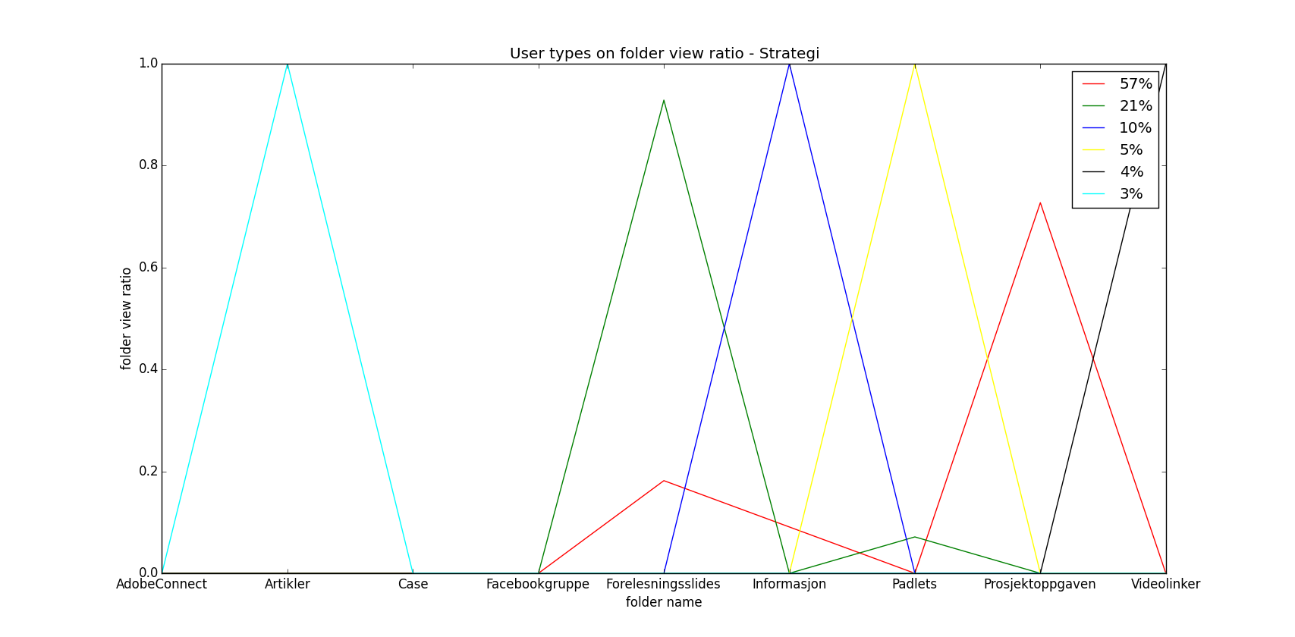
Types of users on there preference viewing folders in courses
Strategi STR3605 course

Slide 13
Types of users on there preference viewing folders in courses
Strategi STR3605 course
57% students spend 73% of their time viewing Project assignment folder but they only spend average 19% time to read lectures.
21% students spend 93% time to read lectures and only 8% to read Project assignment.
2 types of student: one care for assignment and one care for lectures. Which one will get higher grade?
- Very few student view other studying documents as Articles or Case.

Slide 14
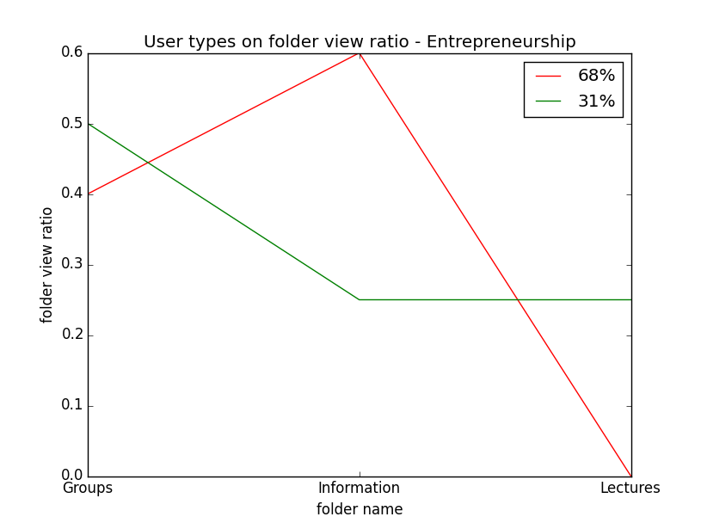
Types of users on there preference viewing folders in courses
Entrepreneurship ELE3702

Slide 15
Types of users on there preference viewing folders in courses
Entrepreneurship ELE3702
- Clearly there are two types of students when viewing folders: 68% have pattern of viewing Groups and Information folder only. 31% care more about lectures

